Slide 1
Attitude Stabilization of a Micro-Aerial Vehicle with Sliding Mode Control
Joe Mockler
ENAE743: Applied Nonlinear Control
7 MAY 24

Slide 2
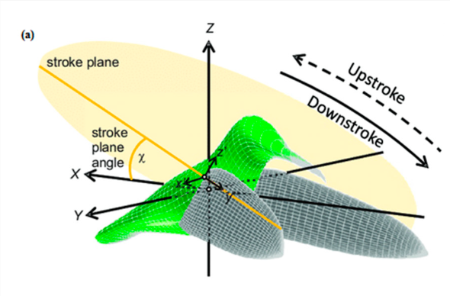
Introduction: What are MAV’s?
Micro-Aerial Vehicles: small fliers that use flapping mechanisms to maneuver and fly [2].
Application areas:
Reconnaissance
Surveillance in hazardous/risky situations
Remote inspection
Active research in aerodynamic modelling and linear/nonlinear control
Reproduced from [6]
Notes:
So what are micro-aerial vehicles? These are small fliers that use a flapping mechanism, usually in high frequency, to maneuver and fly.
Why are we interested? Small, highly maneuverable vehicles are useful for surveillance or inspection in areas humans cant readily go.
Active work in aerodynamic modelling and control – today, we’ll focus on control

Slide 3
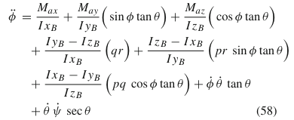
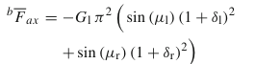
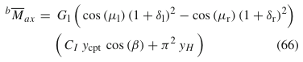
Governing Dynamics
Complete nonlinear models derive equations of motion in the body frame using a cycle-averaging technique [5].
Notes:
Let’s first look at the complete dynamics: Common approach is a cycle averaging which leads to a complete expression for a 6DOF. Only one is called out here, roll dynamics.
To point out some key details, we see the highly nonlinear relationship between the euler angles and rates.
In the forces and moments, the parameters mu and delta come from wing characteristics
For just stabilization, we don’t necessarily need a complete expression, just one that looks at a hovering condition.

Slide 4
Governing Dynamics
Complete nonlinear models derive equations of motion in the body frame using a cycle-averaging technique [5].
Model reduction with [4], [2]
A complete description isn’t necessary for attitude stabilization!
Notes:
We’ll reduce these equations around a stable hovering condition

Slide 5
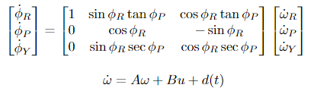
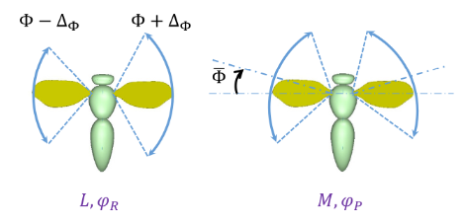
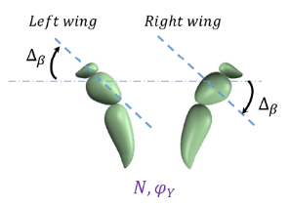
Governing Dynamics
Reduced equations around a hovering condition are deployed on this project
Reproduced from [4]
Notes:
Final dynamic equations we’ll work with.
Nonlinearities are kept in the angular rates, while the hovering inputs (moments and forces from before) are linearized

Slide 6
Governing Dynamics
Reduced equations around a hovering condition are deployed on this project
External disturbance in body frame
Changes to hovering pattern
Reproduced from [4]
Notes:
Point out a few key terms: inputs are changes to nominal hovering condition.
See figure on right
D is an unknown disturbance we’re rejecting.

Slide 7



Sliding Mode Control
First define a sliding surface and a Lyapunov function:
$$s=ω+Gψ$$
$$V\left(s\right)=\frac{1}{2}s^{T}s$$
$$\dot{s}=\dot{ω}+G\dot{ψ}$$
$$\dot{V}(s)=s[\left(Aω+Bu+d\left(t\right)\right)+GT\left(ψ\right)ω]$$
Define an input and substitute [4] :
$$u=−B^{−1}[\left(A+GT\left(ψ\right)\right)ω+\hat{d}+k_{1}s+k_{2}sgn⁡(s)]$$
$$\dot{V}(s)=s[\left(Aω+Bu+d\left(t\right)\right)+GT\left(ψ\right)ω]$$
Notes:
Step one: define a sliding surface and lyap fcn.
Now define an input and we’re going to substitute

Slide 8
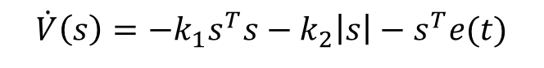
Sliding Mode Control
First define a sliding surface and a Lyapunov function:
$$s=ω+Gψ$$
$$V\left(s\right)=\frac{1}{2}s^{T}s$$
$$\dot{s}=\dot{ω}+G\dot{ψ}$$
$$\dot{V}(s)=s[\left(Aω+Bu+d\left(t\right)\right)+GT\left(ψ\right)ω]$$
Define an input and substitute [4]:
$$u=−B^{−1}[\left(A+GT\left(ψ\right)\right)ω+\hat{d}+k_{1}s+k_{2}sgn⁡(s)]$$
$$\dot{V}(s)=s[\left(Aω+Bu+d\left(t\right)\right)+GT\left(ψ\right)ω]$$
$$\dot{V}\left(s\right)=−k_{1}s^{T}s−k_{2}\left|s\right|−s^{T}(d\left(t\right)−\hat{d})$$
$$\dot{V}\left(s\right)=−k_{1}s^{T}s−k_{2}\left|s\right|−s^{T}e(t)$$
Notes:
We can see that most of the terms cancel and we get 2 neg, def terms and an error term to handle

Slide 9
Sliding Mode Control
First define a sliding surface and a Lyapunov function:
$$s=ω+Gψ$$
$$V\left(s\right)=\frac{1}{2}s^{T}s$$
$$\dot{s}=\dot{ω}+G\dot{ψ}$$
$$\dot{V}(s)=s[\left(Aω+Bu+d\left(t\right)\right)+GT\left(ψ\right)ω]$$
Key control objectives:
The controller shall stabilize the origin (hovering) from non-zero initial conditions
The controller shall reject unknown external disturbances
Define an input and substitute [4]:
$$u=−B^{−1}[\left(A+GT\left(ψ\right)\right)ω+\hat{d}+k_{1}s+k_{2}sgn⁡(s)]$$
$$\dot{V}(s)=s[\left(Aω+Bu+d\left(t\right)\right)+GT\left(ψ\right)ω]$$
$$\dot{V}\left(s\right)=−k_{1}s^{T}s−k_{2}\left|s\right|−s^{T}(d\left(t\right)−\hat{d})$$
$$\dot{V}\left(s\right)=−k_{1}s^{T}s−k_{2}\left|s\right|−s^{T}e(t)$$
Notes:
Let’s use this to prove we can meet some control objectives
Read them out

Slide 10
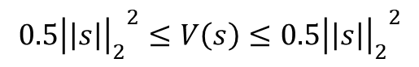
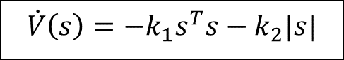


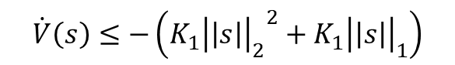
Sliding Mode Control
Consider a few cases:
1) Assume zero estimate error
$$\dot{V}\left(s\right)=−k_{1}s^{T}s−k_{2}|s|$$
1)
$${{0.5\left|\left|s\right|\right|}_{2}}^{2}≤V\left(s\right)≤{{0.5\left|\left|s\right|\right|}_{2}}^{2}$$
$$\dot{V}\left(s\right)≤−\left(K_{1}{{\left|\left|s\right|\right|}_{2}}^{2}+K_{1}{\left|\left|s\right|\right|}_{1}\right)$$
2)
$$≤−C{\left|\left|s\right|\right|}^{2}$$
$$\left|∂V/∂s\right|=|s|≤{\left|s\right|}_{1}$$
3)
→ Theorem 4.14: the origin is exponentially stable! [9]
Notes:
Case one: say there’s no error. Then it’s clearly neg def and we can show it’s exponentially stable

Slide 11

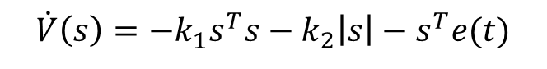

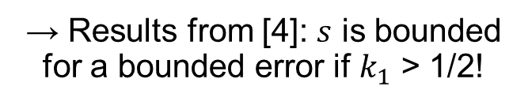
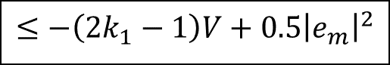
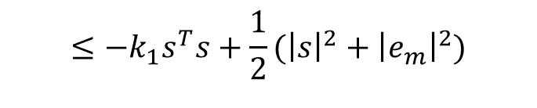
Sliding Mode Control
Consider a few cases:
1) Assume zero estimate error
2) Assume finite error
$$\dot{V}\left(s\right)=−k_{1}s^{T}s−k_{2}|s|$$
$$\dot{V}\left(s\right)=−k_{1}s^{T}s−k_{2}\left|s\right|−s^{T}e(t)$$
→ Let $e_{m}=\max_{t}{e\left(t\right)}$
1)
$${{0.5\left|\left|s\right|\right|}_{2}}^{2}≤V\left(s\right)≤{{0.5\left|\left|s\right|\right|}_{2}}^{2}$$
$$≤−k_{1}s^{T}s+|s||e_{m}|$$
$$\dot{V}\left(s\right)≤−\left(K_{1}{{\left|\left|s\right|\right|}_{2}}^{2}+K_{1}{\left|\left|s\right|\right|}_{1}\right)$$
$$≤−k_{1}s^{T}s+\frac{1}{2}({\left|s\right|}^{2}+{\left|e_{m}\right|}^{2})$$
2)
$$≤−C{\left|\left|s\right|\right|}^{2}$$
$$≤−\left(2k_{1}−1\right)V+0.5{\left|e_{m}\right|}^{2}$$
$$\left|∂V/∂s\right|=|s|≤{\left|s\right|}_{1}$$
3)
→ Theorem 4.14: the origin is exponentially stable! [9]
→ Results from [4]: $s$ is bounded for a bounded error if $k_{1}$ > 1/2!
Notes:
Case one: say there’s bounded error. Then I’ve followed the results from [4] and showed that s is at bounded under a bounded error

Slide 12
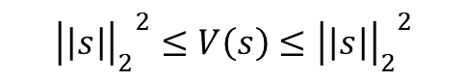
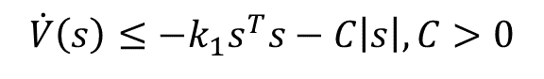

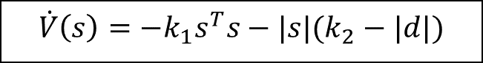
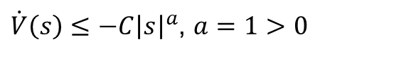
Sliding Mode Control
Consider a few cases:
3) Assume error is bound by constant |d|
$$\dot{V}\left(s\right)=−k_{1}s^{T}s−|s|(k_{2}−|d|)$$
→ Let $k_{2}≥|\max_{t}{d\left(t\right)}|$*
$$\dot{V}\left(s\right)≤−k_{1}s^{T}s−C\left|s\right|, C>0$$
$${{\left|\left|s\right|\right|}_{2}}^{2}≤V\left(s\right)≤{{\left|\left|s\right|\right|}_{2}}^{2}$$
1)
2)
$\dot{V}\left(s\right)≤−C{\left|s\right|}^{a}$, $a=1>0$
→ Theorem 4.10: the origin globally exponentially stable!
*This represents an engineering design decision that can be satisfied with general knowledge of operating environment
Notes:
Finally, if we assume that the error is bound by d(t) and we use k2 to constrain the system, the s = 0 is GUAS.

Slide 13
Sliding Mode Control
Consider a few cases:
3) Assume error is bound by constant |d|
$$\dot{V}\left(s\right)=−k_{1}s^{T}s−|s|(k_{2}−|d|)$$
Key control objectives:
The controller shall stabilize the system from non-zero initial conditions – Case 1 ✓
The controller shall reject unknown external disturbances – Case 2, 3 ✓ if error is bounded
→ Let $k_{2}≥|\max_{t}{d\left(t\right)}|$*
$$\dot{V}\left(s\right)≤−k_{1}s^{T}s−C\left|s\right|, C>0$$
$${{\left|\left|s\right|\right|}_{2}}^{2}≤V\left(s\right)≤{{\left|\left|s\right|\right|}_{2}}^{2}$$
1)
2)
$\dot{V}\left(s\right)≤−C{\left|s\right|}^{a}$, $a=1>0$
→ Theorem 4.10: the origin globally exponentially stable!
*This represents an engineering design decision that can be satisfied with general knowledge of operating environment
Notes:
Now, we’ve met our control objectives!

Slide 14
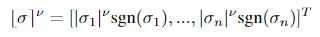
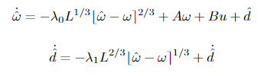
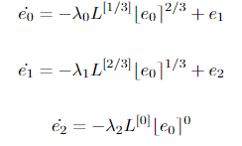
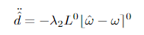



Observer Design
Goal: error must be bounded and less than the disturbances
Approach: make use of results in [4], [10], [11]
Observer dynamics
Error dynamics
$$e_{0}=\hat{ω}−ω$$
$$e_{1}=\hat{d}−d$$
$$e_{2}=\hat{\dot{d}}−\dot{d}$$
Notes:
Recall we must get a bounded e(t) for all t. Follow results from 10, 11
When error in this term, these papers prove finite time convergence.

Slide 15
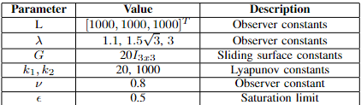
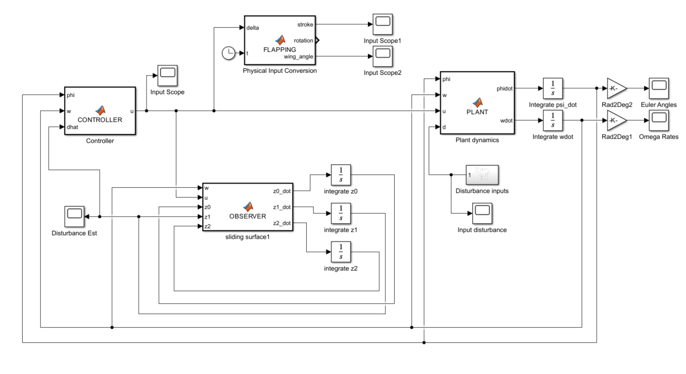
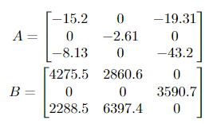
Simulation Construction
A, B from [2], [4]
Notes:
Set the whole thing up in Simulink, gave it the following parameters satisifying the conditions
Make note of putting sat(s) in WLOG and tuning the saturation limit.

Slide 16
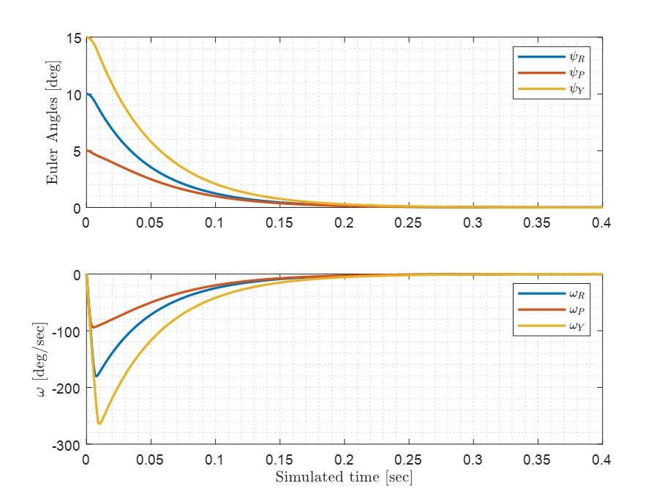
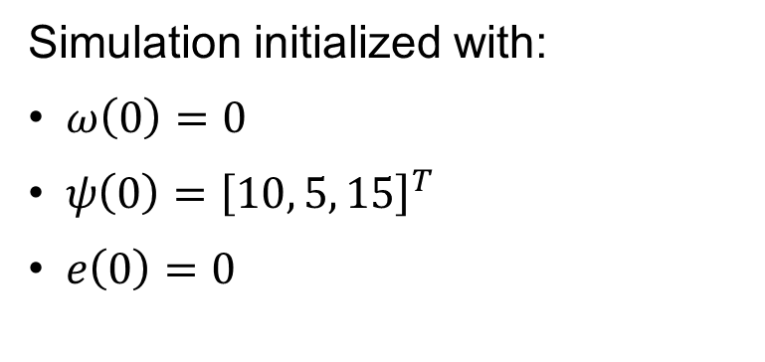
Simulation Results: Initial Condition
Simulation initialized with:
$ω\left(0\right)=0$
$ψ\left(0\right)={\left[10, 5, 15\right]}^{T}$
$e\left(0\right)=0$
Key control objectives:
The controller shall stabilize the system from non-zero initial conditions ✓

Slide 17
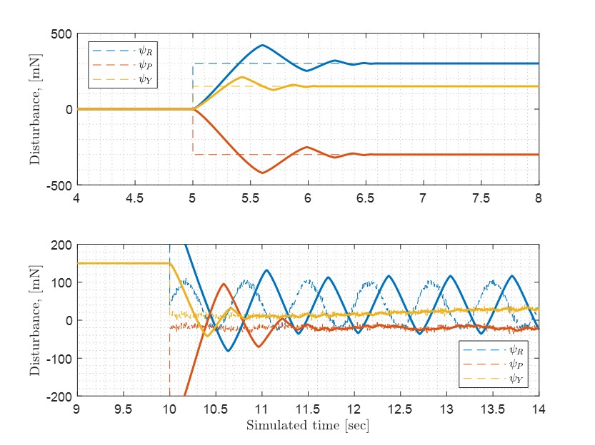
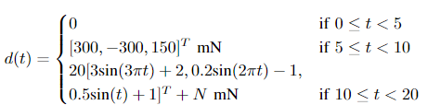
Simulation Results: Disturbance Estimation
Dashed: injected disturbances
Solid: disturbance recreation

Slide 18
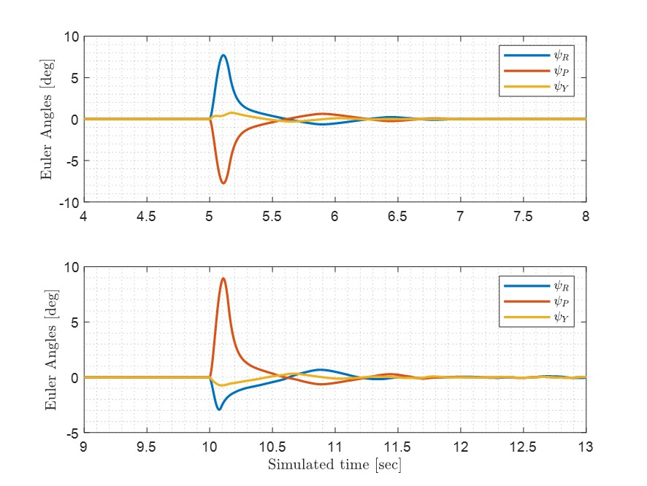
Simulation Results: Disturbance Response
Small oscillations persist under a time-varying disturbance (result 2)
Key control objectives:
2. The controller shall reject unknown external disturbances ✓

Slide 19
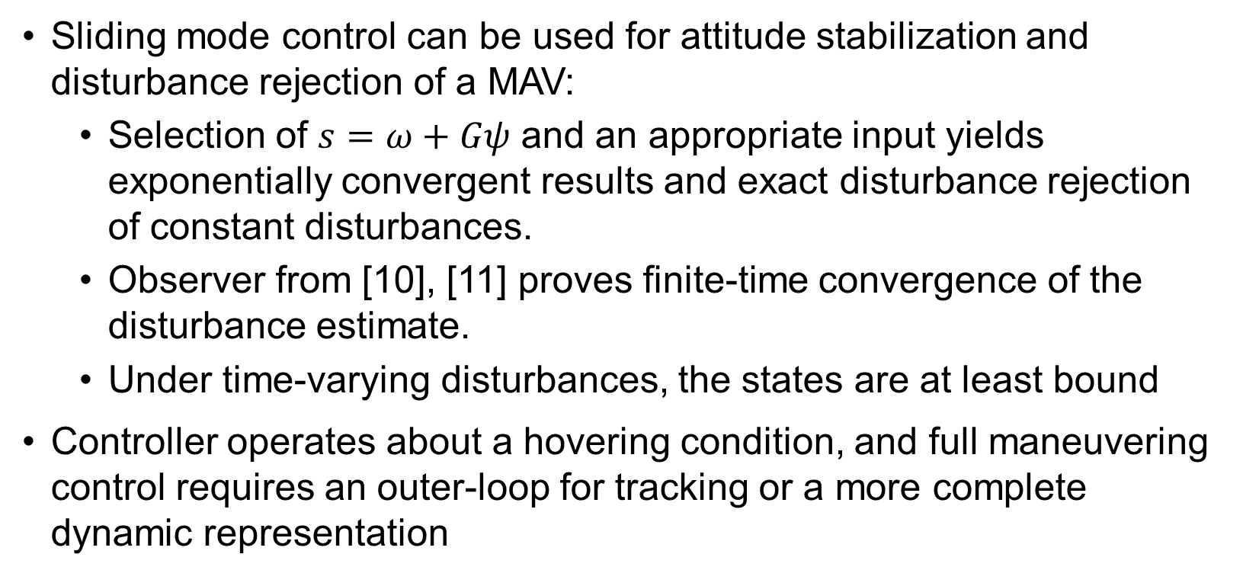
Conclusions
Sliding mode control can be used for attitude stabilization and disturbance rejection of a MAV:
Selection of $s=ω+Gψ$ and an appropriate input yields exponentially convergent results and exact disturbance rejection of constant disturbances.
Observer from [10], [11] proves finite-time convergence of the disturbance estimate.
Under time-varying disturbances, the states are at least bound
Controller operates about a hovering condition, and full maneuvering control requires an outer-loop for tracking or a more complete dynamic representation

Slide 20
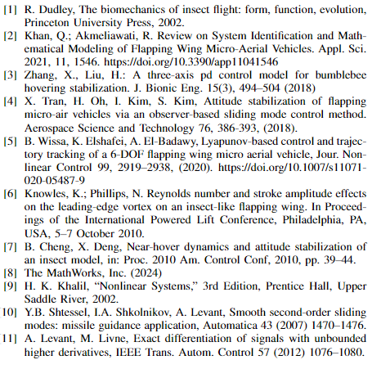
Citations

Slide 21
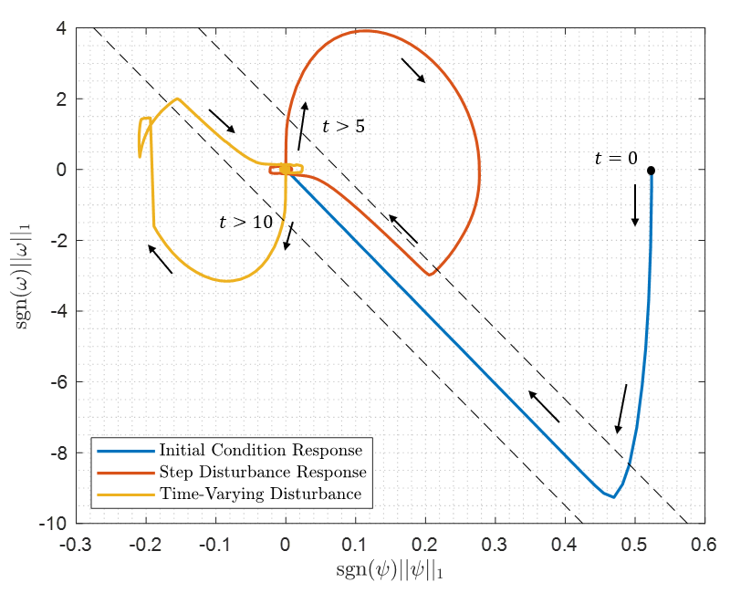
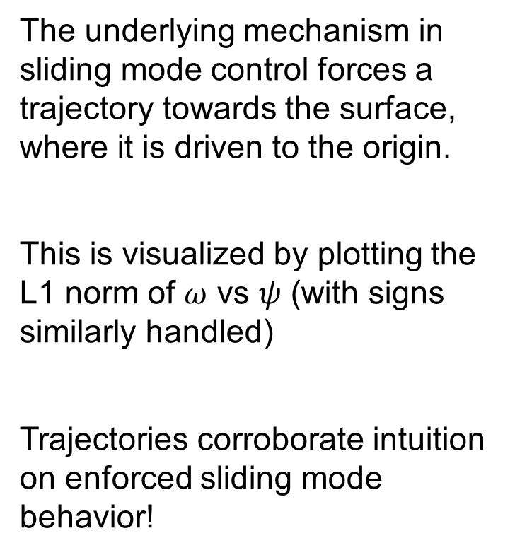
Appendix: Sliding Mode Analysis
The underlying mechanism in sliding mode control forces a trajectory towards the surface, where it is driven to the origin.
This is visualized by plotting the L1 norm of $ω$ vs $ψ$ (with signs similarly handled)
Trajectories corroborate intuition on enforced sliding mode behavior!

Slide 22
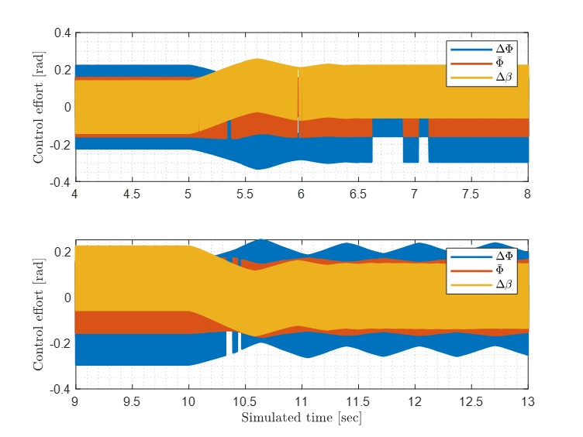
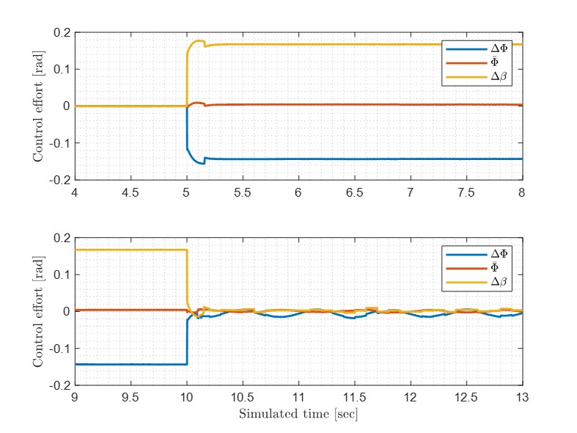
Appendix: Control Effort pre vs post chattering

Slide 23
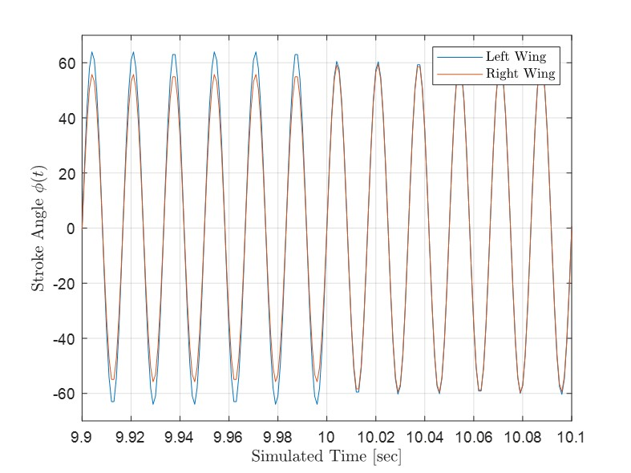
Appendix: Example hovering control

